Slide 1
Chapter 5 – EFWI of the
Moere Vest data set

Slide 2
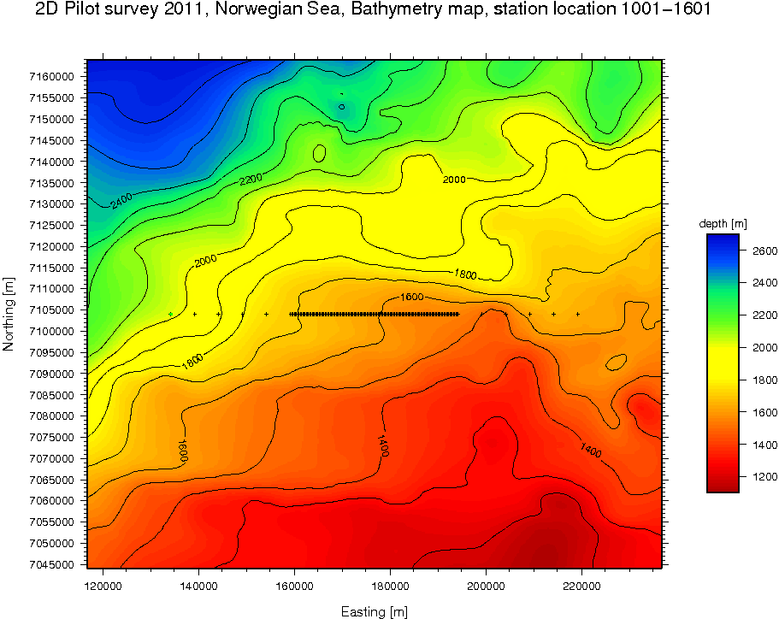
Chapter 5
Offshore Norway - provided by Seabed Geosolutions
2D 85 km receiver line
2D 110 km shot line (100 m sampling)
Long offset spread:
12 nodes (6 each side)
5km between nodes
adds 50km to line
Regular spread:
141 4C nodes (Hydrophone + 3 Geophones)
250m between nodes
35km line

Slide 3
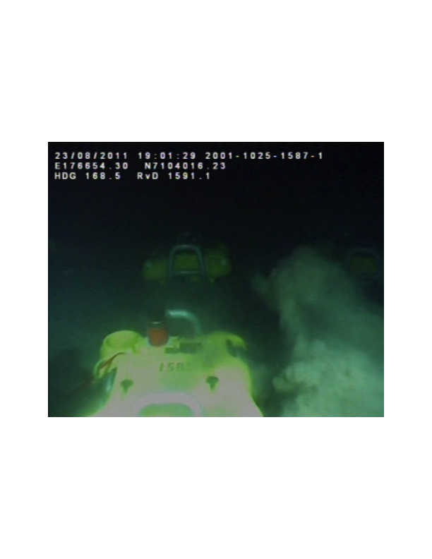
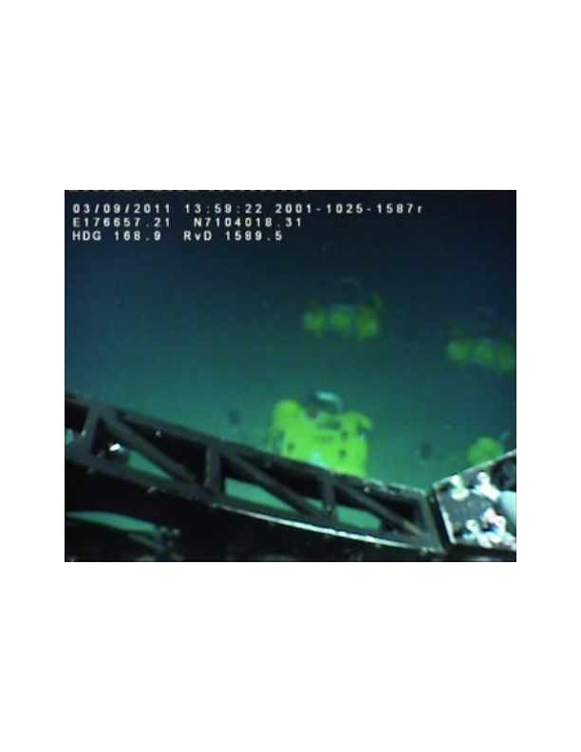
The Moere Vest data
ROV camera during nodes deployment

Slide 4
The Moere Vest data
ROV camera during nodes deployment

Slide 5
The Moere Vest data

Slide 6
The Moere Vest data
~ 55 km offset

Slide 7
The Moere Vest data

Slide 9
Primary
reflections
Refractions
Refractions
Multiples

Slide 10
Inputs of Elastic FWI
Pre-processing of field data
Properties model
Raw data
Data rotation
Receiver designature
De-bubble
Initial properties model
Initial Vp/Vs
Elastic RTM

Slide 11
Data pre-processing - Rotation
y
x
Raw data
Data rotation
Receiver de-signature
De-bubble
The initial orientation depends on the placement of the nodes by the ROV.
y’
x’
To find the right alignment, the data is rotated until the amplitude of the
first break is maximum in the inline (x’) direction.

Slide 12
Data pre-processing - Rotation

Slide 13
Data pre-processing - Rotation

Slide 14
Data pre-processing – Receiver designature
Raw data
Data rotation
Receiver de-signature
De-bubble
Data de-convolution (Wiener filter):
Notice the difference in receiver response of multi-component data.

Slide 15
Data pre-processing – De-bubble
Raw data
Data rotation
Receiver de-signature
De-bubble

Slide 16
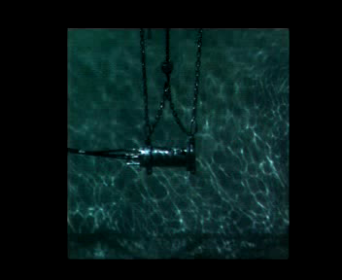
Data pre-processing – De-bubble
Raw data
Data rotation
Receiver de-signature
De-bubble

Slide 17
Data pre-processing – De-bubble
Raw data
Data rotation
Receiver de-signature
De-bubble

Slide 18
Data pre-processing – De-bubble
Raw data
Data rotation
Receiver de-signature
De-bubble

Slide 19
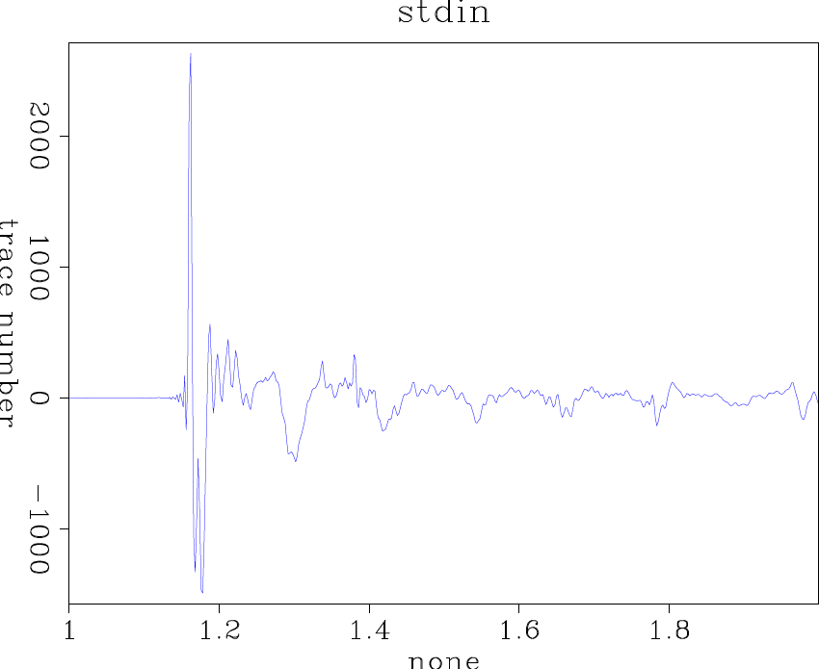
Data pre-processing – De-bubble
Raw data
Data rotation
Receiver de-signature
De-bubble

Slide 20
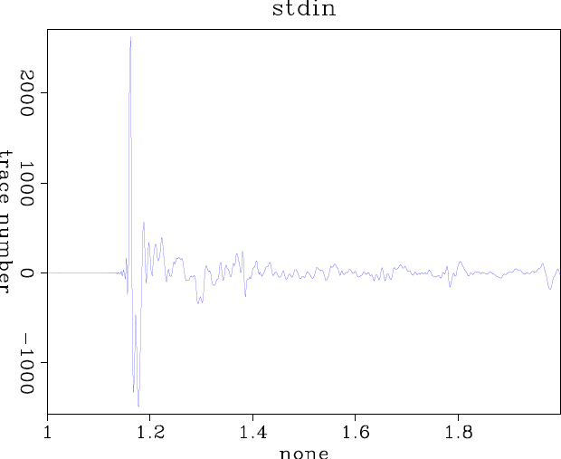
Data pre-processing – De-bubble
Raw data
Data rotation
Receiver de-signature
De-bubble

Slide 21
Initial properties model
Properties model
How to create an initial model for multi-parameter inversion?
  How smooth should be the initial model?
  What is the initial shear velocity?
  How do strong contrasts (basalt) affect elastic data?
Initial properties model
Initial Vp/Vs
Elastic RTM
INITIAL MODEL ESTIMATION FOR ELASTIC FWI IS CHALLENGING!

Slide 25
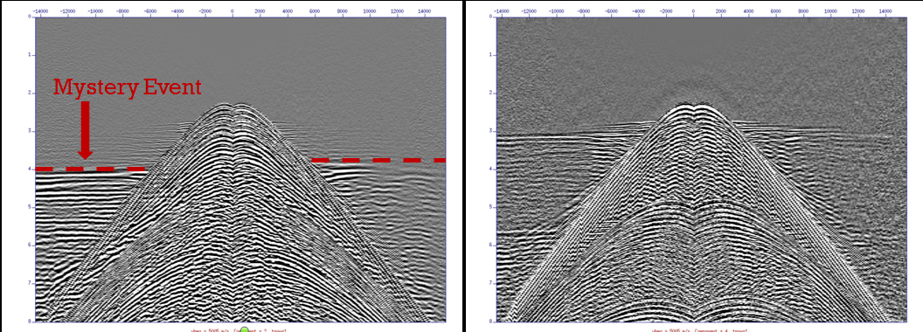
LMO of field data
Initial properties model
Initial Vp/Vs
Elastic RTM
Horizontal geophone
Hydrophone
Moronfoye, et al., Upper-Crustal Structure of the Moere Vest Margin, offshore Norway, AGU, 2016

Slide 26
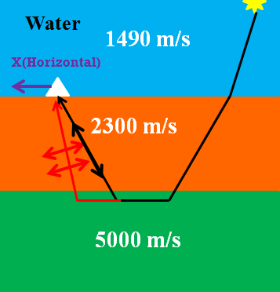
LMO of field data
Initial properties model
Initial Vp/Vs
Elastic RTM
Vp/Vs ratio of 1.72 in the shallow
sedimentary layer, for which
Vs = 1340 m/s.
Moronfoye, et al., Upper-Crustal Structure of the Moere Vest Margin, offshore Norway, AGU, 2016

Slide 27
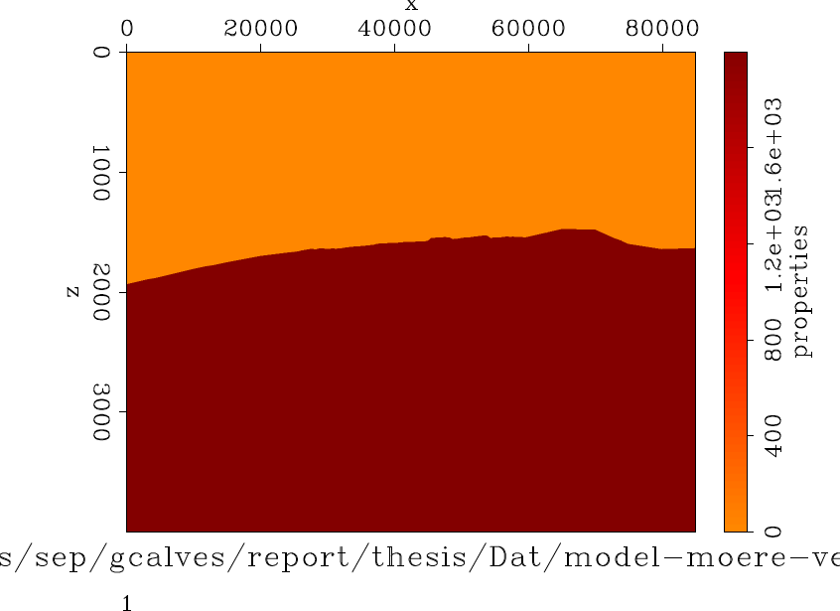
Initial properties model
Initial properties model
Initial Vp/Vs
Elastic RTM
V_{p} = 1500 m/s
V_{s} = 0 m/s
V_{p} = 2300 m/s
V_{s} = 1340 m/s

Slide 28
Building the initial model – Elastic RTM
Initial properties model
Initial Vp/Vs
Elastic RTM

Slide 29
Building the initial model – Smooth initial model

Slide 30
EFWI objective function

Slide 31
EFWI objective function
Objective function
L₂ norm
Elastic modeling operator
Real or observed data
(4C: Hydrophone, vertical and horizontal geophones)
Property model
(ρ,V_{P},V_{S})

Slide 32
EFWI objective function
Python solver
Objective function
L₂ norm
Elastic modeling operator
Real or observed data
(4C: Hydrophone, vertical and horizontal geophones)
Property model
(ρ,V_{P},V_{S})

Slide 33
EFWI objective function
Python solver
Elastic operator
Objective function
L₂ norm
Elastic modeling operator
Real or observed data
(4C: Hydrophone, vertical and horizontal geophones)
*ALWAYS invert for
the source wavelet
Property model
(ρ,V_{P},V_{S})

Slide 34
EFWI objective function
Python solver
Elastic operator
Pre-processing
Objective function
L₂ norm
Elastic modeling operator
Real or observed data
(4C: Hydrophone, vertical and horizontal geophones)
Property model
(ρ,V_{P},V_{S})

Slide 35
EFWI objective function
Python solver
Elastic operator
Pre-processing
Initial model
Objective function
L₂ norm
Elastic modeling operator
Real or observed data
(4C: Hydrophone, vertical and horizontal geophones)
Property model
(ρ,V_{P},V_{S})

Slide 36
EFWI
I am using conjugate-gradients to calculate the search direction and the step lengths are found by parabolic search.
I start the inversion 2-5 Hz data, followed by 2-7.5 Hz and finally 2-10 Hz.
I tested 15 km offset, 12 s data and also 5 km offset, 5 s data.
I used spatial reciprocity to generate data in common receiver gathers and not common shot.

Slide 37
EFWI with residual and gradient weights

Slide 38
EFWI with residual and gradient weights

Slide 39
EFWI with residual and gradient weights

Slide 40
EFWI with residual and gradient weights

Slide 41
EFWI with residual and gradient weights

Slide 42
EFWI with residual and gradient weights

Slide 43
EFWI with residual and gradient weights

Slide 44
EFWI with residual and gradient weights

Slide 45
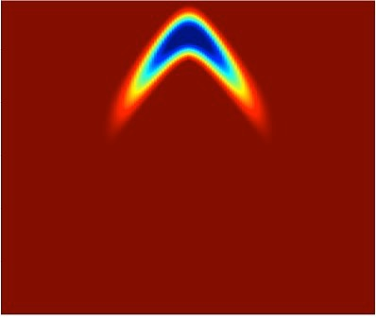
EFWI with residual and gradient weights

Slide 46
EFWI with residual and gradient weights - detail

Slide 47
EFWI with residual and gradient weights

Slide 48
EFWI with residual and gradient weights

Slide 49
EFWI with residual and gradient weights

Slide 50
EFWI with residual and gradient weights

Slide 51
EFWI with residual and gradient weights

Slide 52
EFWI with residual and gradient weights

Slide 53
EFWI with residual and gradient weights

Slide 54
EFWI with residual and gradient weights

Slide 55
EFWI with residual and gradient weights

Slide 56
EFWI with residual and gradient weights

Slide 57
EFWI with residual and gradient weights

Slide 58
EFWI with residual and gradient weights

Slide 59
EFWI with residual and gradient weights

Slide 60
EFWI with residual and gradient weights

Slide 61
EFWI with residual and gradient weights

Slide 62
Vp-Vs ratio of inverted models

Slide 63
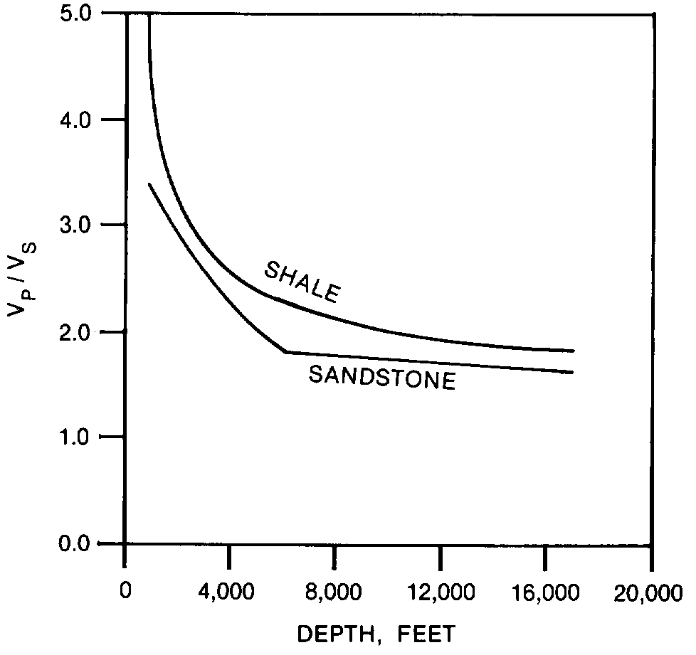
Vp-Vs ratio of inverted models
Castagna, et al., 1985
1.5 – 1.8 water saturated sandstones
> 2.2 shales
~1.8 – 2.1 (basalt)

Slide 64
Comparing ERTM before and after EFWI

Slide 65
Comparing ERTM before and after EFWI

Slide 66
Comparing ERTM before and after EFWI

Slide 67
Comparing ERTM before and after EFWI

Slide 68
Comparing ERTM before and after EFWI

Slide 69
Comparing ERTM before and after EFWI

